Slide 2
Build and Deploy
APP Course
Notes:
Ask some questions
How many have used GitHub?
How many have used GitHub Actions?

Slide 3
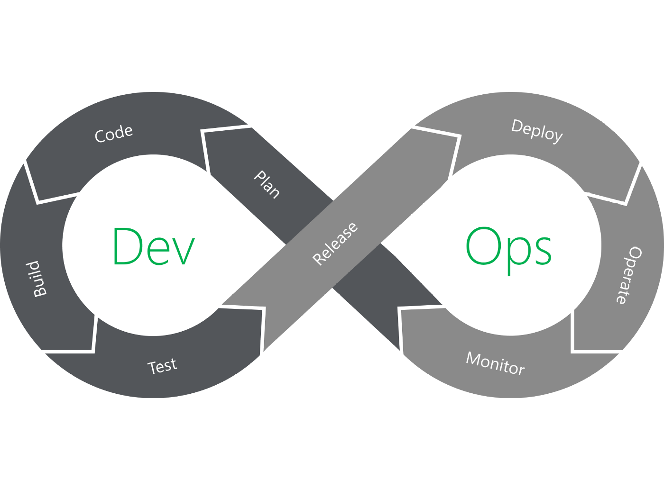
DevOps
Notes:
Development and operations combined
Release
A software version that can be installed somewhere
Deploy
Installing that software somewhere

Slide 4
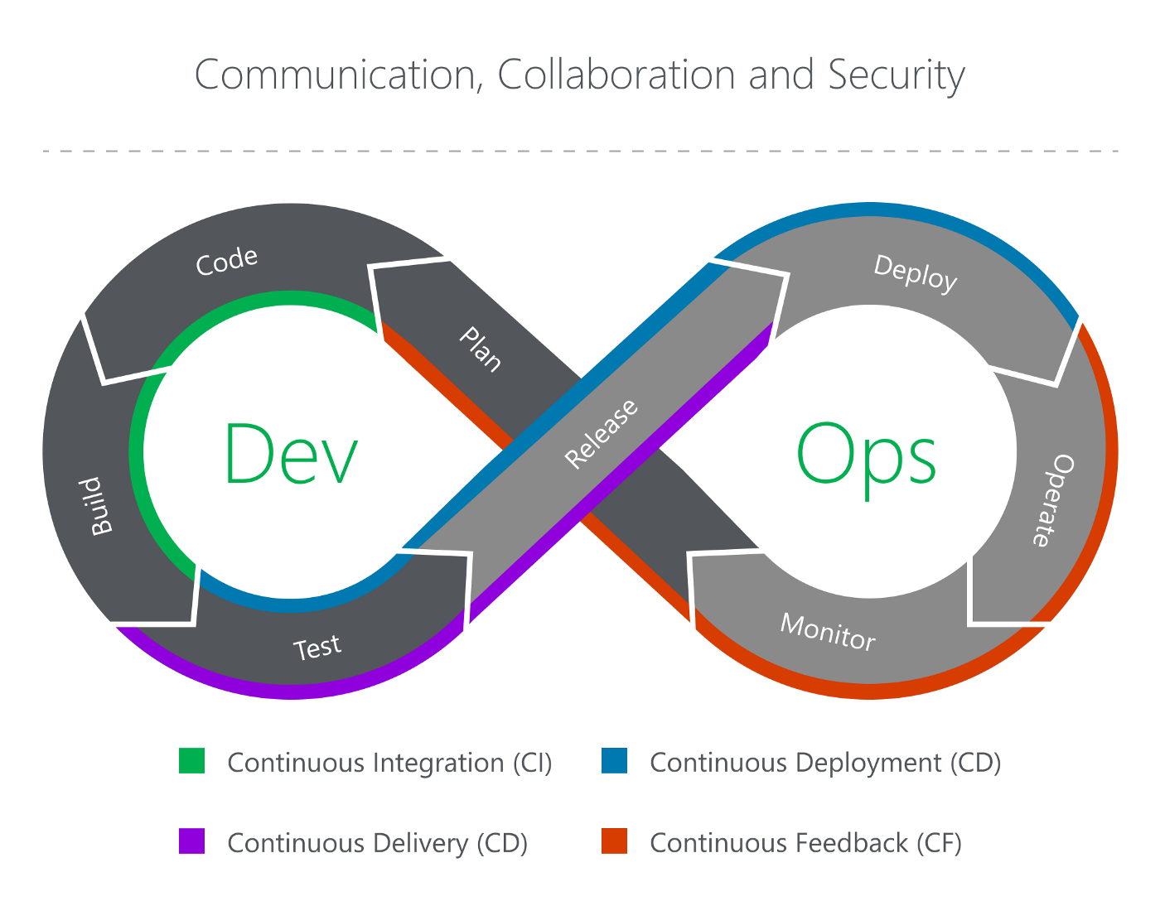
CI & CD
DevOps
Notes:
We want to automate as much as possible of this loop
CI
Build
CD
Deploy

Slide 5
What is build and deploy?
Build
Deploy
Compilation
Results in executables
Deliver executables to an environment

Slide 6





Suppliers

Slide 7
A typical work process
process
Plukke en oppgave
Lage en feature-brach
Kode og teste
Lage en pull request (PR)
Pull request validation
Code review
Fullføre pull request (PR)
Bygg
Deploy til testmiljø
Deploy til produksjon
Notes:
Bygg og deploy på slutten
PR validation
Kjøre tester

Slide 8
“GitHub Actions is a continuous integration and continuous delivery (CI/CD) platform that allows you to automate your build, test, and deployment pipeline”
- github

Slide 9
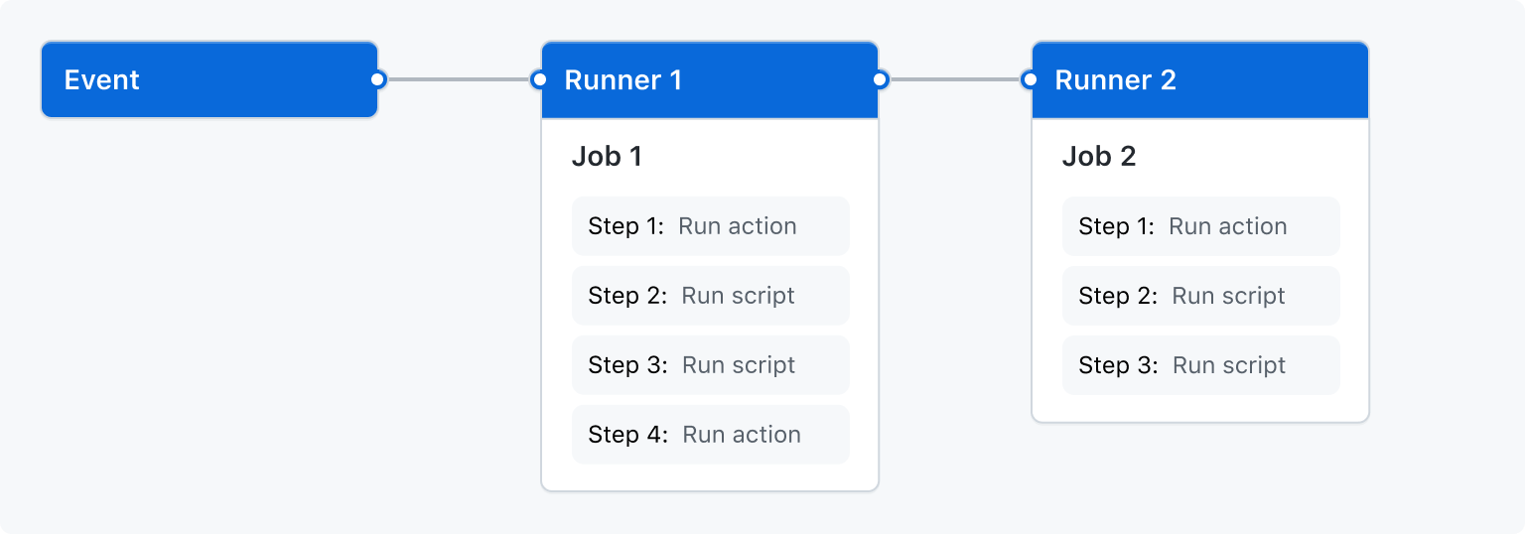
Workflow
GitHub Actions
Notes:
Event
PR
Push
Manuel start
Job
Et set av steg som skal gjennomføres på en runner
Runner
En server
Kjører stegene dine

Slide 10
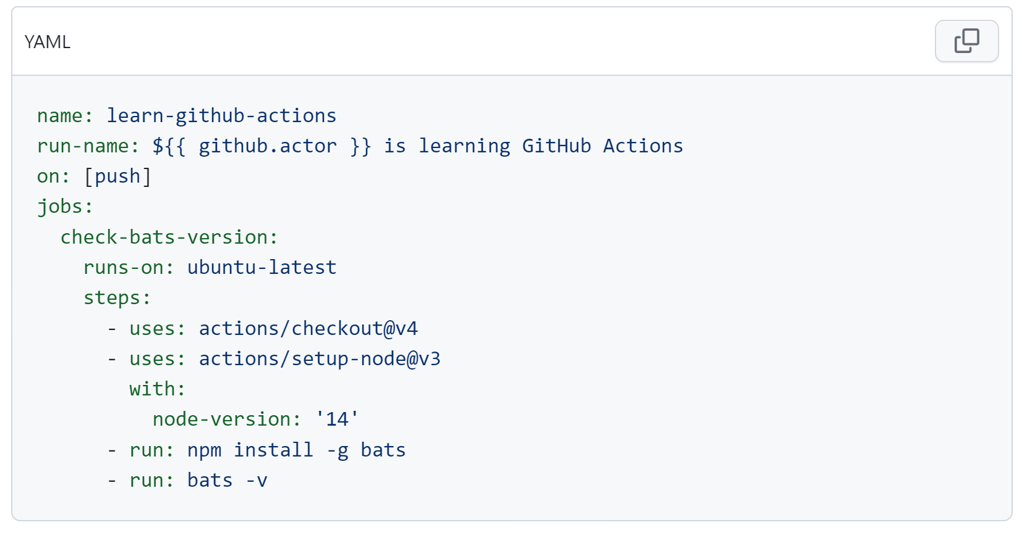
Example
GitHub Actions

Slide 11
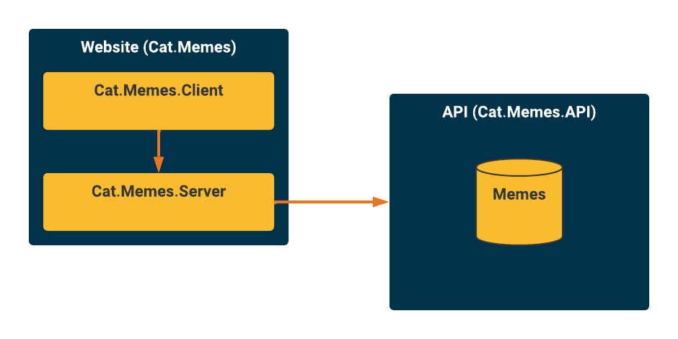
Workshop Architecture
Workshop

Slide 12
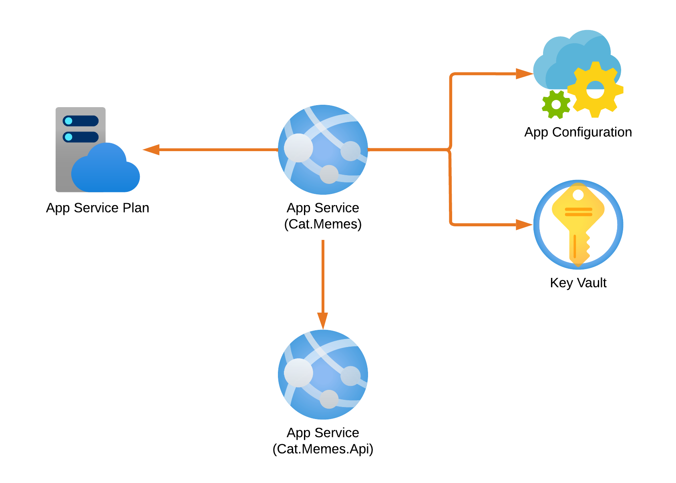
Workshop Cloud architecture
Workshop

Slide 13
Workshop Solve Part 1
https://github.com/Omegapoint-Norge-Academy/build-and-deploy
Notes:
Intro
What are we going to do
Create a web app and deploy an app
When finished
Explain built pipeline
Trigger (on)
Jobs
Steps
Prebuilt components
Custom parameters
Gihub marketplace
https://github.com/marketplace?type=actions
Artifact
Deploy needs build
Publish profile
Find the secret in settings secrets and variables
Take questions

Slide 14
Workshop Solve Part 2
https://github.com/Omegapoint-Norge-Academy/build-and-deploy
Notes:
Intro
What are we going to do
Add configuration and secrets
Explain App configuration
Explain Key Vault
Explain managed identity and how the app gets access
When finished
Explain the code in the app (that adds config and key vault)
Take questions

Slide 15
Workshop Solve Part 3
https://github.com/Omegapoint-Norge-Academy/build-and-deploy
Notes:
Intro
What are we going to do
Automate tests
When finished
Explain the code in the app (that adds config and key vault)
Take questions

Slide 16
Multiple environments
Environments
Multiple deploy jobs
Different App configuration and secrets
Approval on job start for each environment
Notes:
Show in GitHub
View of build and deploy and explain adding a job

Slide 17
PR validation
Pull requests
Branch policy
Don’t push directly to main
Require PR
Require reviewer approvement
Require build and tests to succeed
Notes:
Demonstrate
New feature branch
New PR
Observe build
Talk through the workflow
Show branch protection rules
If time to kill
Extend workshop by asking participants to create PR validation build and branch protection rules

Slide 18
We are done Keep on learning!

